Slide 1

Sales Forecasting Using Machine Learning
Team Members:
Shiva Kandagatla (700745245)
Snigdha Tula(700735877)
Anitha Anumanthula(700742467)
Venkat Sai Jagini(700744860)

Slide 2
Roles and responsibilities:
Team Member 1 worked on the coding for the XGBoost Model, Linear model and Random Forest algorithm.
Team member 2 worked on the documentation for the project.
Team Member 3 worked on the features derivation for the project to move forward.
Team member 4 worked on the reference papers and helped in choosing the models based on existing models.

Slide 3
Motivation:
Use of technology for learning in a variety of fields, including banking, sales, and advertising.
Be able to predict how changes will impact a company's evolution.
Recognizing the purchasing habits of the consumers' retail establishments offering improved service quality.
Growing the sales.

Slide 4

Objectives:
Predicting purchase:
Implementing a machine learning system to demonstrate a customer's spending capacity.
Pattern recognition:
Recognizing the data-driven elements that affect spending.
Quantitative impact of revealed factors.

Slide 5

Related work:
In e-commerce, there are several tools available to forecast sales, such as time series prediction.
massive crowds, steep discounts on goods.First work used linear regression model to predict.
C. M. Wu has suggested a forecasting framework to investigate consumer's buying history but also forecast consumer spending mostly in upcoming.
Purvika Bajaj utilizing information gathered out of a supermarket, did sales figures. Linear Regression, and Random Forest are the algorithms employed in experiments.
Finally, future consumer intentions are discussed along with purchase trends.

Slide 6

Problem Statement:
Understand customer buying behavior, especially purchase amounts, based on different products and different categories.
Shared the purchase summary of many customers on selected products which are of high volume.

Slide 7

Proposed Solution:
Linear Regression
Linear Regression is an algorithm that belongs to supervised Machine Learning.
It tries to apply relations that will predict the outcome of an event based on the independent variable data points.
Random Forest
In some cases, the classification and regression objectives are both met.
Without always relying on just one DT, the random forest philosophy uses several DT.
XGBoost
a variety of regularizations to reduce overfitting and improve overall effectiveness.
utilizing suitable normalization methods and improving particular loss functions.

Slide 8
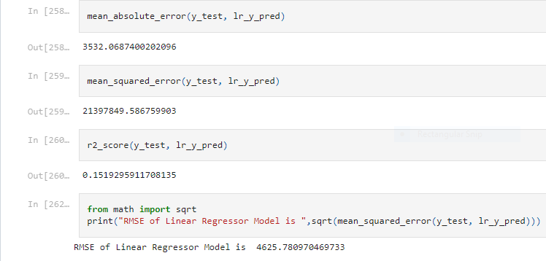
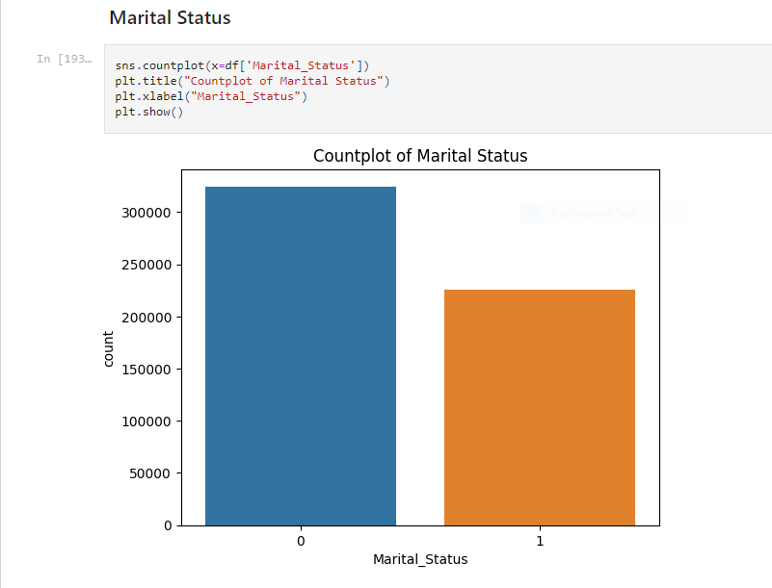
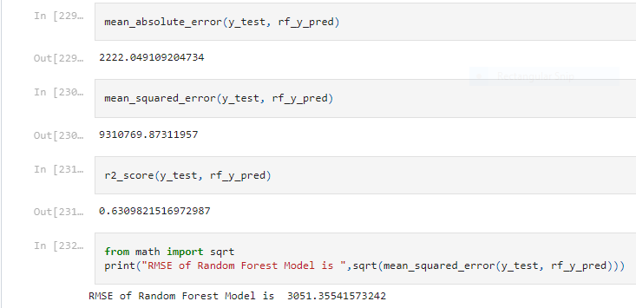
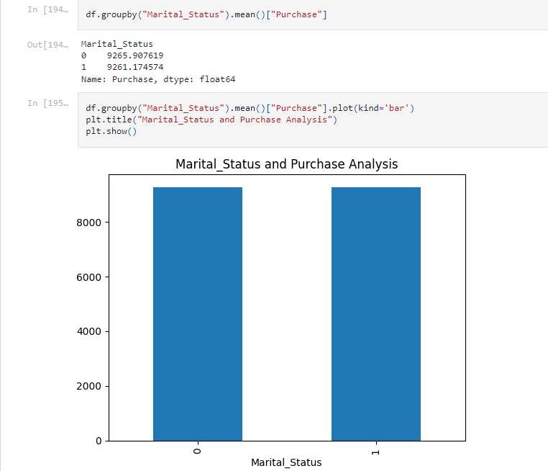
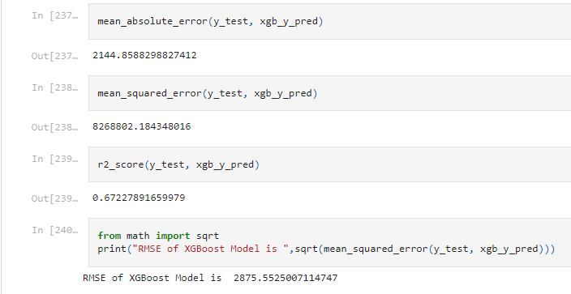
Results\Simulations:

Slide 9
References:
C. M. Wu, P. Patil and S. Gunaseelan, "Comparison of Different Machine Learning Algorithms for Multiple Regression on Black Friday Sales Data," 2018 IEEE 9th International Conference on Software Engineering and Service Science (ICSESS), 2018, pp. 16-20, doi: 10.1109/ICSESS.2018.8663760.
Odegua, Rising. (2020). Applied Machine Learning for Supermarket Sales Prediction.
Purvika Bajaj1, Renesa Ray2, Shivani Shedge3, Shravani Vidhate4, Prof. Dr. Nikhilkumar Shardoor5,”SALES PREDICTION USING MACHINE LEARNING ALGORITHMS'',International Research Journal of Engineering and Technology (IRJET) ,Vol 7 Issue 6,2020,eISSN: 2395-0056 p-ISSN: 2395-0072.
Ramasubbareddy S., Srinivas T.A.S., Govinda K., Swetha E. (2021) Sales Analysis on Back Friday Using Machine Learning Techniques. In: Satapathy S., Bhateja V., Janakiramaiah B., Chen YW. (eds) Intelligent System Design. Advances in Intelligent Systems and Computing, vol 1171. Springer, Singapore.
Potturi, Keerthan, "Black Friday A study of consumer behavior and sales predictions" (2021). Creative Components.

Slide 10


